Slide 1

Academy
Web Performance
https://github.com/thelarkinn/webpack-workshop-2018
https://frontendmasters.com/courses/performance-webpack/

Slide 2
Web Performance

Slide 3
Top 3 Web Page Load Time Causes:
Amount of JavaScript For Initial Download
Amount of CSS For Initial Download
AMount of Network Requests on Initial Download

Slide 4
Goals:
<=200kb (UNCOMPRESSED) Initial JavaScript [total]
<=100kb (UNCOMPRESSED) Initial CSS [total]
HTTP: <= 6 Initial Network Calls
HTTP/2: <= 20 Initial Network Calls
90% Code Coverage (only 10% code unused)

Slide 5
Code Splitting

Slide 6
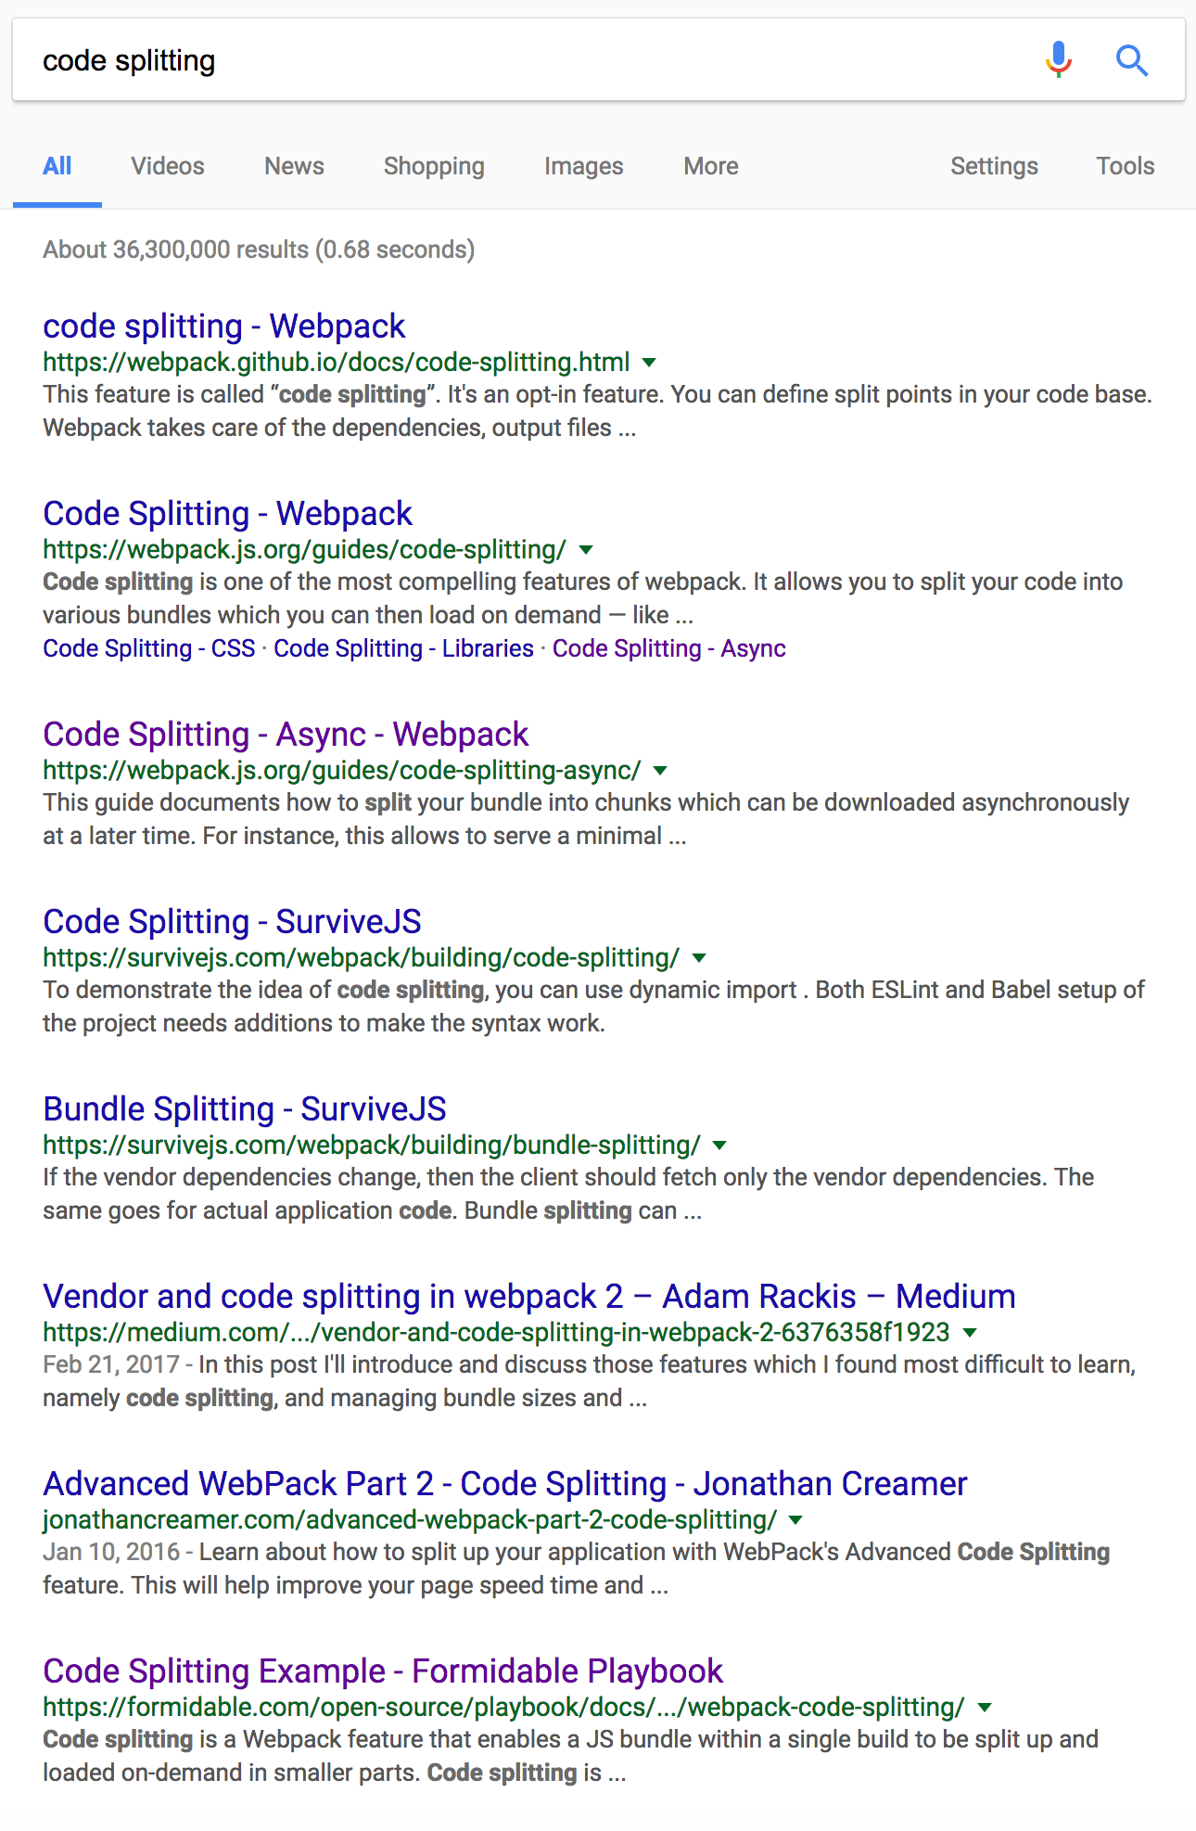
Code Splitting

Slide 7



Slide 8
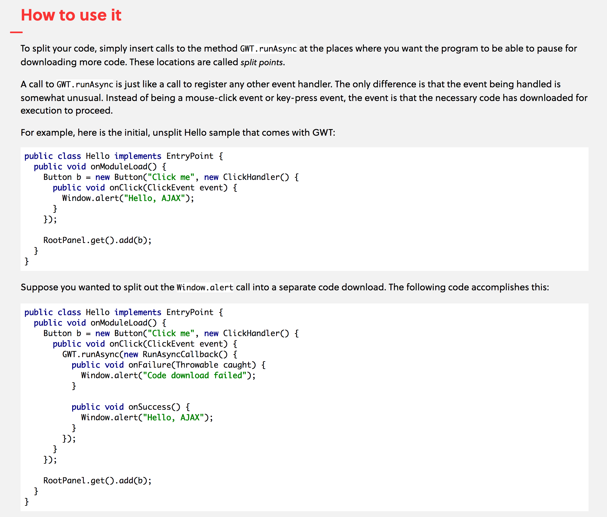

Slide 10
Code Splitting
Process of splitting pieces of your code into async chunks [at build time]

Slide 11
How Does it Work?

Slide 12
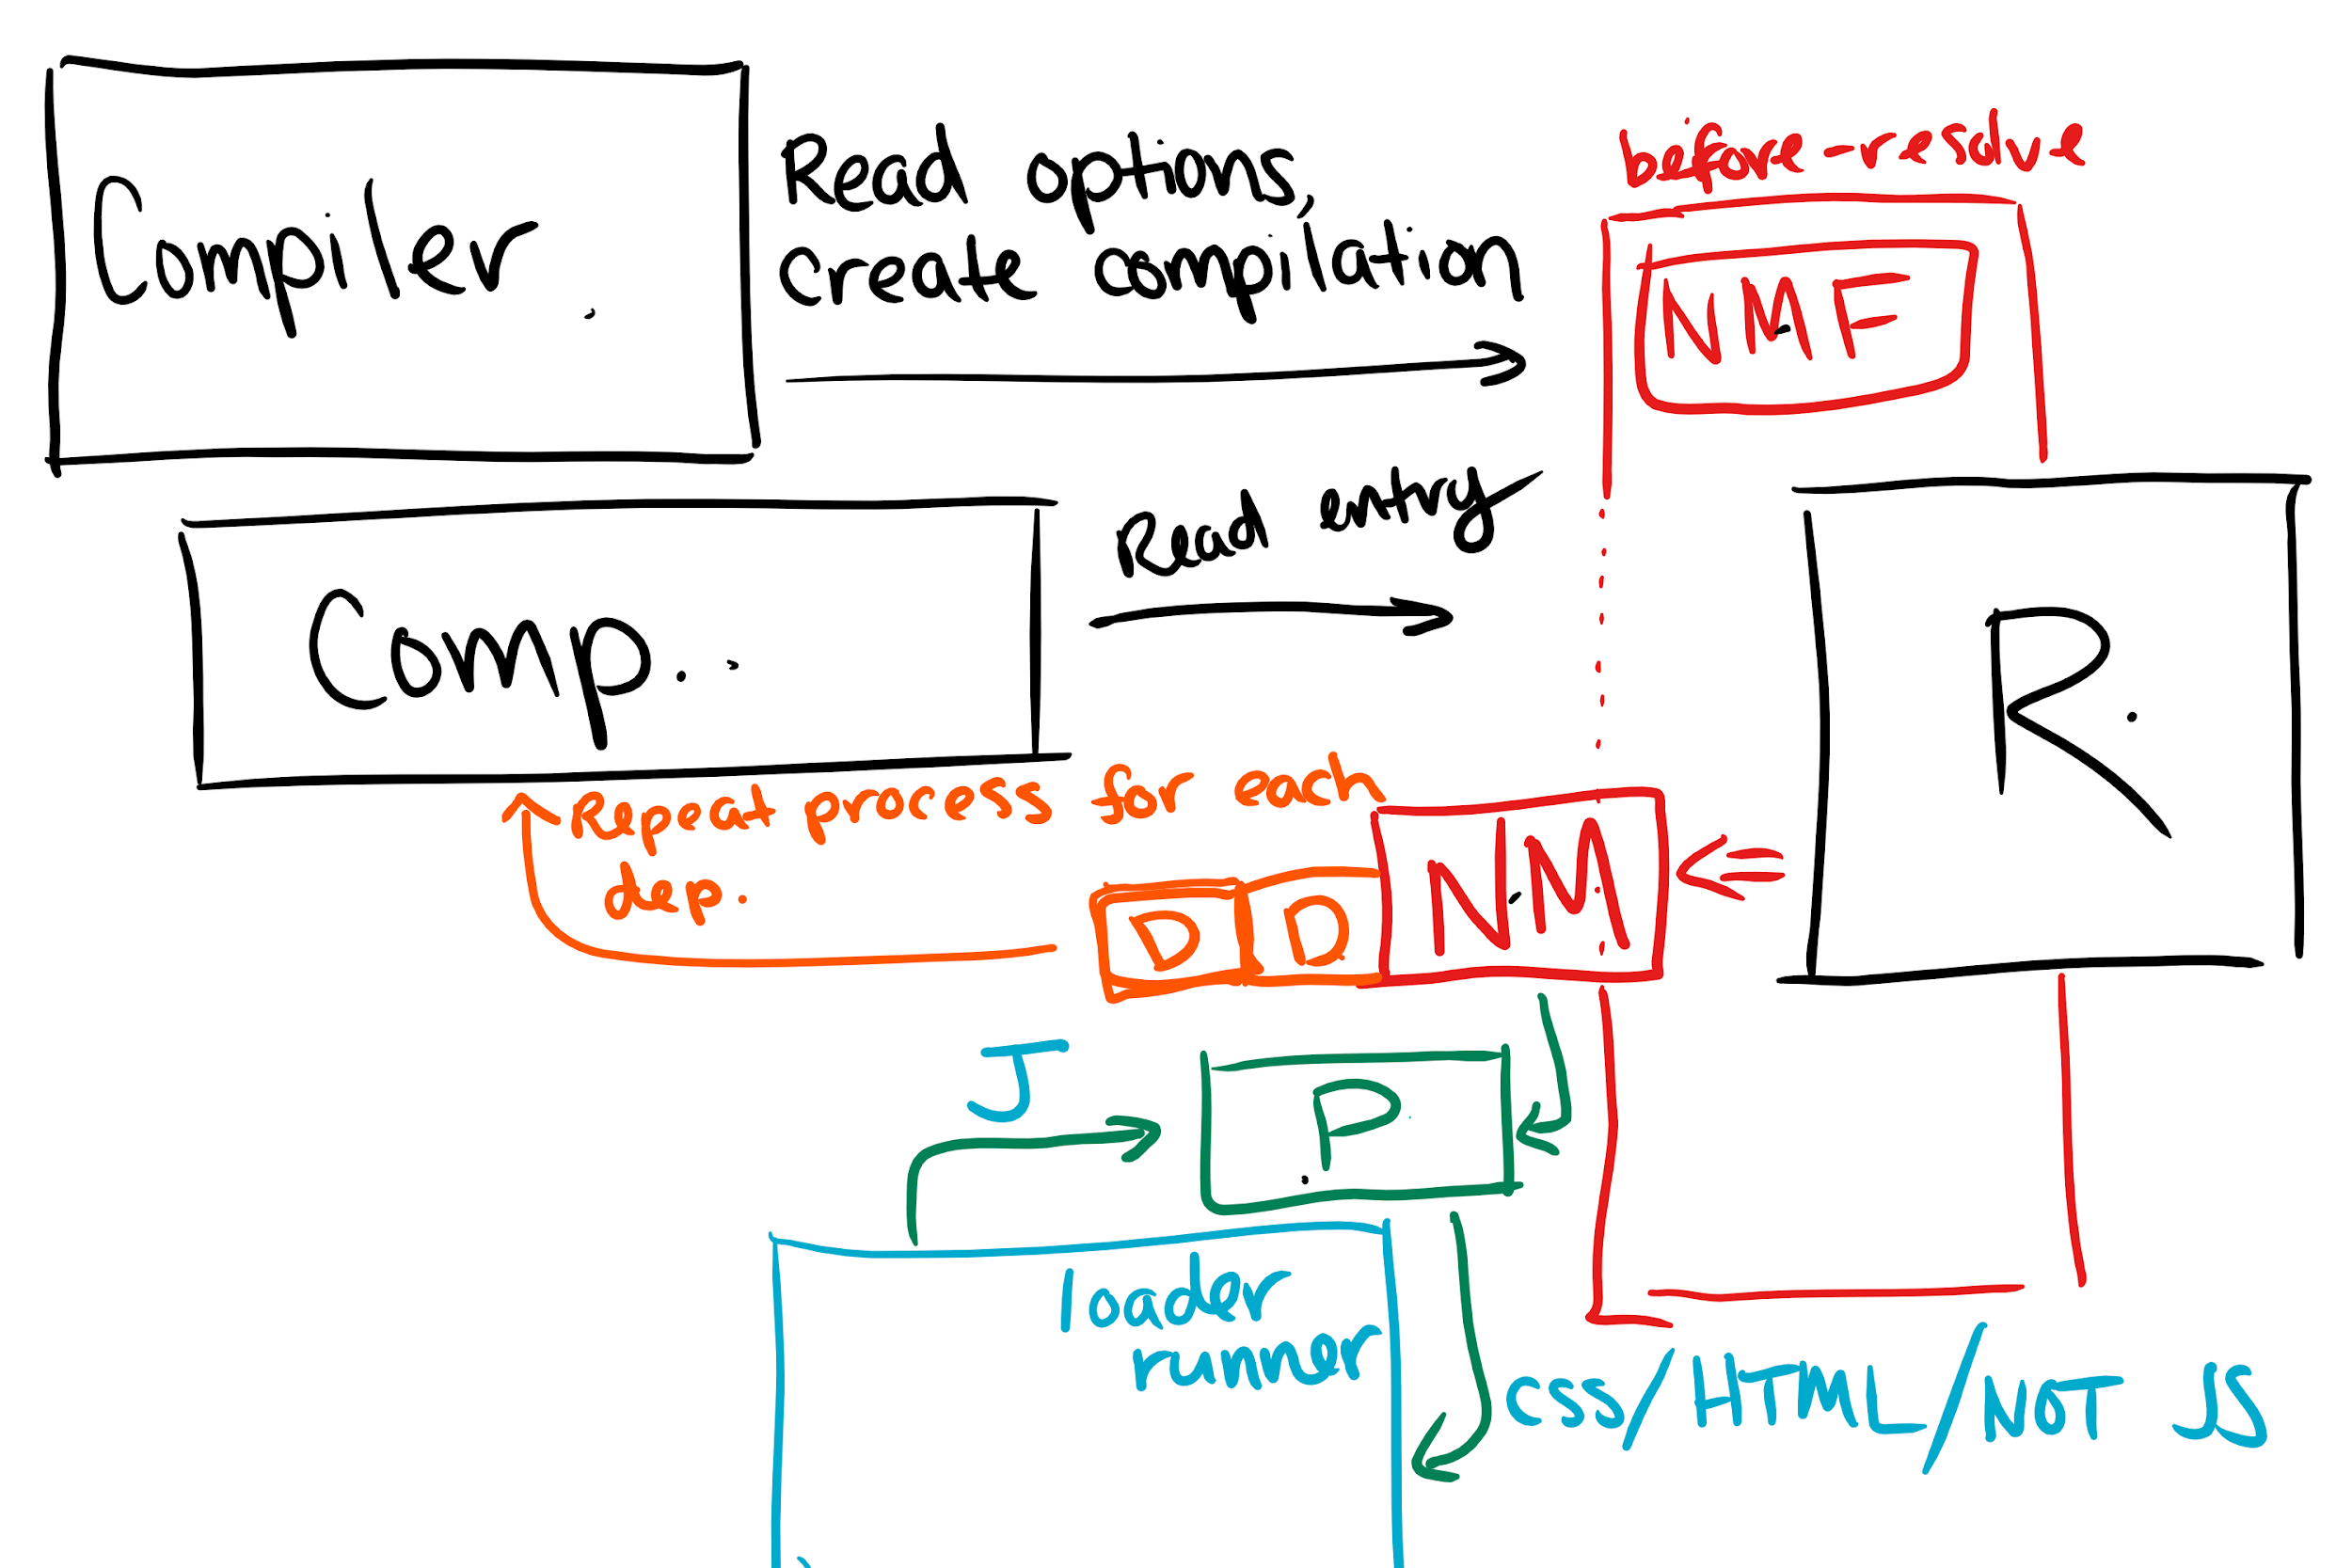
How...

Slide 13
Why should I care?

Slide 14
Why...
The future of web is mobile
The average mobile website takes 14 seconds to get interactive
load less code => interactive faster.

Slide 15
Two Types

Slide 16
Two Types
static
“dynamic”

Slide 17
Static

Slide 18
When to use:
“HEavy” JavaScript
Anything temporal
Routes

Slide 19
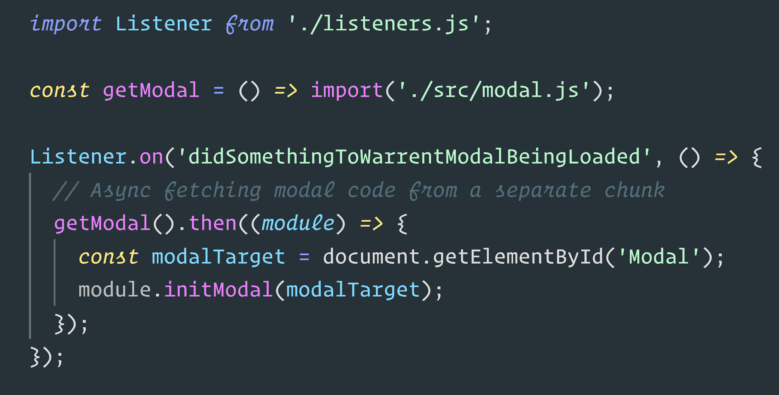

Slide 20
Always returns a Promise

Slide 21
Async:
Sync:
app.js
modal.js
listeners.js

Slide 22
Async:
Sync:
app.js
modal.js
listeners.js

Slide 23
Async:
Sync:
app.js
0.chunk.js
bundle.js
modal.js
listeners.js

Slide 24
“Dynamic”

Slide 25
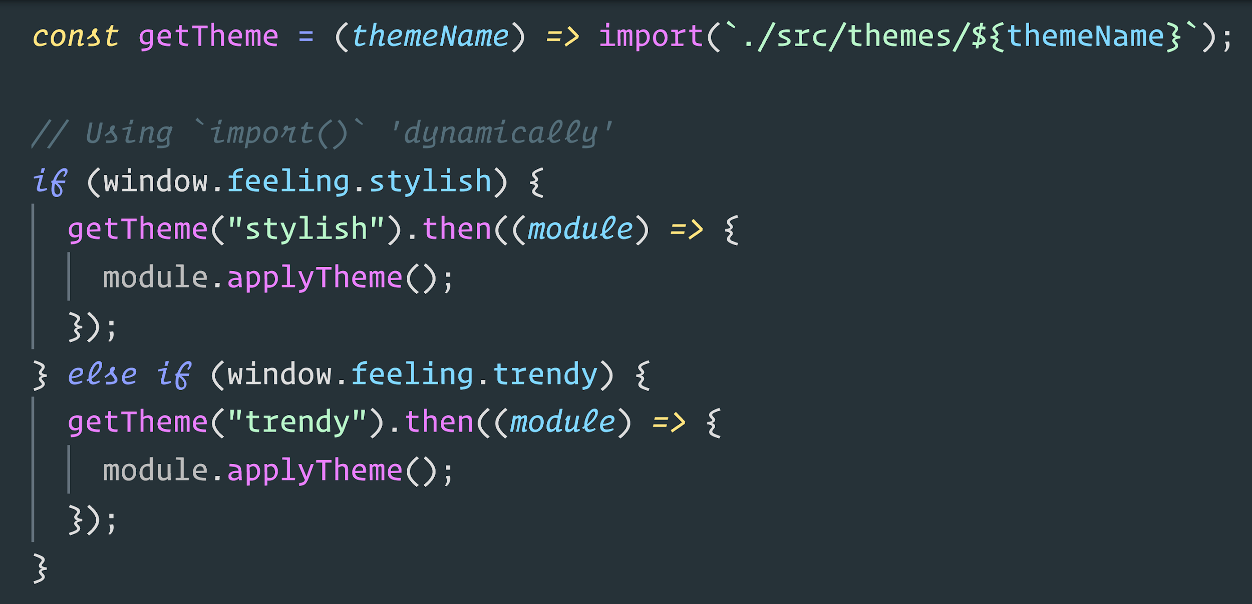

Slide 26
Loading an async bundle based on runtime conditions

Slide 27
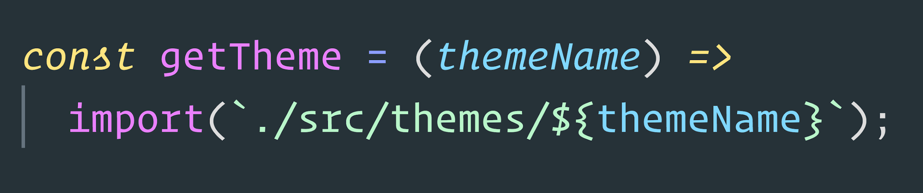
Breakdown

Slide 28
partial path
expression
directory
resolvable
Context
Module
ContextModule!!!

Slide 29
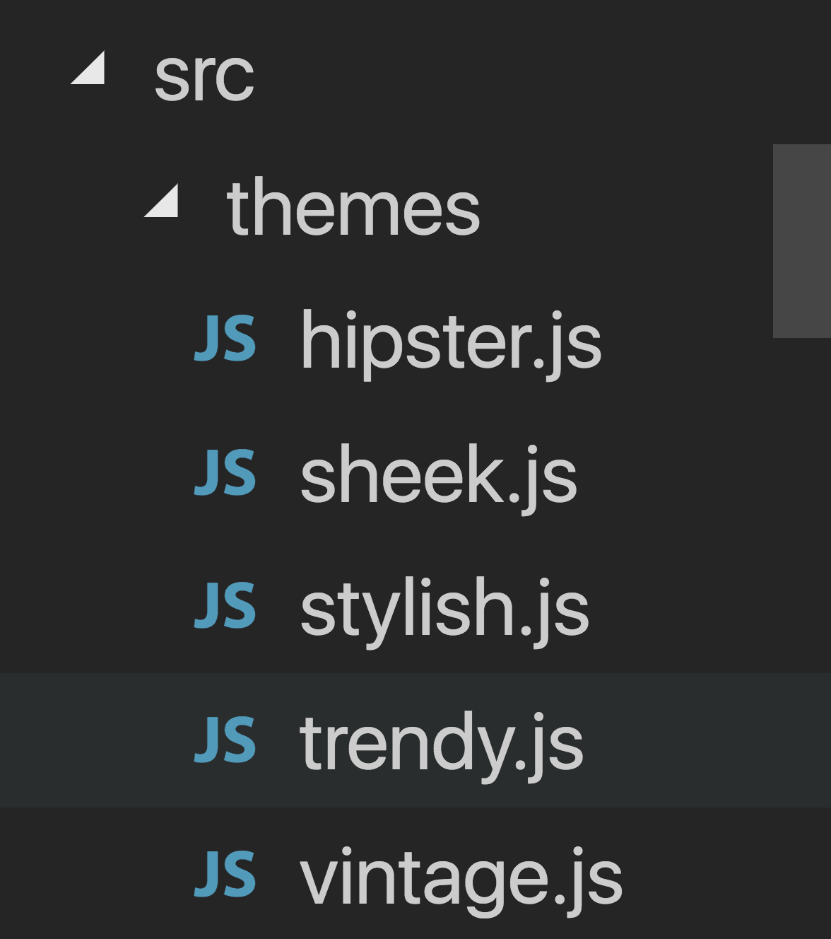
“Hey webpack! Find me all modules in this partial path”
0.chunk.js
1.chunk.js
2.chunk.js
3.chunk.js
4.chunk.js

Slide 30
When to use:
AB Testing
Theming
Convenience

Slide 31
Exercise Time

Slide 32
NOte: Always focus on splitting before caching

Slide 33
Perf Scenarios

Slide 34
HTTP/2

Slide 35
Service Worker

Slide 36
Progressive Web Applications

Slide 37
Performance Hints

Slide 38
Building For Node?

Slide 39
Should you?

Slide 40
Building For Node?

Slide 41
Should you?

Slide 42
Building For Electron?

Slide 43
Should you?

Slide 44
Building For Libs?

Slide 45
Should you?

